Slide 1



Design Specification for Stack Data Structure

Slide 2

Identify the Data Structures
A data structure is a storage that is used to store and organize data. It is a way of arranging data on a computer so that it can be accessed and updated efficiently.
A data structure is not only used for organizing the data. It is also used for processing, retrieving, and storing data. Different basic and advanced types of data structures are used in almost every program or software system that has been developed. So we must have good knowledge of data structures

Slide 3
Define the Operations
The primary operations of a memory stack include:
Push: Adds an item to the top of the stack.
Pop: Removes the item from the top of the stack.
Peek (or Top): Returns the item on the top of the stack without removing it.
IsEmpty: Checks if the stack is empty.
Size: Returns the number of items currently in the stack.

Slide 4
Specify Input Parameters
A data structure is a storage that is used to store and organize data. It is a way of arranging data on a computer so that it can be accessed and updated efficiently.
A data structure is not only used for organizing the data. It is also used for processing, retrieving, and storing data. Different basic and advanced types of data structures are used in almost every program or software system that has been developed. So we must have good knowledge of data structures

Slide 5
Define Pre- and Post-conditions
Pre-conditions are conditions that must be true before a function is executed, while post-conditions are the expected outcomes after the function has run.
Example:
For the factorial function:
Pre-condition:
n must be a non-negative integer (i.e., n >= 0).
Post-condition:
The function returns an integer that is the product of all positive integers up to n.
If n is 0, the function returns 1 (since 0! = 1).

Slide 6
Discuss Time and Space Complexity
Time and space complexity are measures of the efficiency of an algorithm.
Time Complexity: Describes how the runtime of an algorithm increases relative to the input size.
For the factorial function (using recursion), the time complexity is O(n) because it makes n recursive calls.
Space Complexity: Describes how the memory usage of an algorithm increases relative to the input size.
For the recursive factorial function, the space complexity is also O(n) due to the call stack used by recursion.

Slide 7
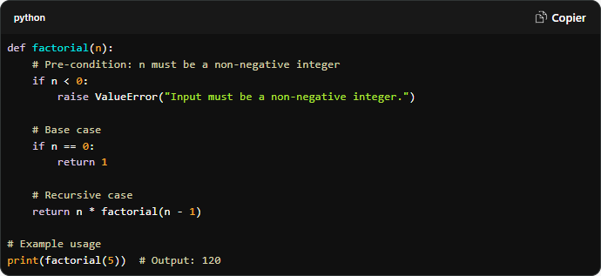
Provide Examples and Code Snippets (if applicable)

Slide 8
Determine the operations of a memory stack and how it is used to implement function

Slide 9
Identify Operations
The primary operations of a memory stack include:
Push: Adds an item to the top of the stack.
Pop: Removes the item from the top of the stack.
Peek (or Top): Returns the item on the top of the stack without removing it.
IsEmpty: Checks if the stack is empty.
Size: Returns the number of items currently in the stack.

Slide 10
Function Call Implementation

Slide 11
Demonstrate Stack Frames
Each function call creates a stack frame, which contains:
Return Address: Where to return after the function completes.
Function Parameters: Input data for the function.
Local Variables: Variables that are local to the function.
Saved Registers: Any registers that need to be preserved across function calls.

Slide 12
Discuss the Importance
The memory stack is crucial for several reasons:
Function Management: It provides a systematic way to manage function calls and returns.
Local Variable Storage: Local variables are stored in a way that they are automatically cleaned up when a function exits.
Recursion Support: The stack enables recursive function calls, allowing functions to call themselves.
Efficient Memory Use: Stack memory is typically faster to allocate and deallocate compared to heap memory.
Control Flow: It maintains the order of function calls, ensuring that each function returns to the correct place in the code.
Discuss the Importance of Sorting Algorithms
Sorting algorithms play a crucial role in computer science and programming for several reasons:

Slide 13
Function Call Implementation
1. Efficiency in Data Organization
Accessibility: Sorted data is easier to search through. For example, binary search, which operates in O(log n) time, can only be performed on sorted data. This dramatically improves search efficiency compared to linear search (O(n)).
Data Retrieval: Many applications require data to be presented in a specific order (e.g., alphabetical, numerical). Sorting algorithms help achieve this efficiently.
2. Foundation for Other Algorithms
Sorting is often a preliminary step for more complex algorithms. For instance, many algorithms in computational geometry, machine learning (like k-nearest neighbors), and data analysis rely on sorted data for optimal performance.
Some algorithms, like merge sort, are specifically designed to work with divide-and-conquer approaches, which are foundational to many data processing techniques.
3. Performance Considerations
Algorithm Choice: Understanding the time and space complexities of sorting algorithms helps developers choose the right algorithm based on the dataset size and structure. For instance:
QuickSort: Preferred for smaller datasets due to its in-place sorting and average-case efficiency.
MergeSort: Preferred for larger datasets or when stability is required, despite its higher space complexity.
Adaptability: Some algorithms perform better with specific types of data. For example, QuickSort can be optimized with good pivot selection strategies, while MergeSort excels with linked lists.
4. Stability and Data Integrity
Importance of Stability: In applications where the order of equal elements is critical (like sorting records by multiple fields), a stable sorting algorithm like MergeSort is necessary. This ensures that the original relative order of similar records is maintained.
Data Consistency: For applications like financial transactions or user data management, maintaining the integrity of data order during sorting can prevent errors or misinterpretations.
5. Real-World Applications
Databases: Sorting is fundamental in database management systems (DBMS) for indexing and querying. Efficient sorting algorithms can drastically reduce query response times.
User Interfaces: Applications that display lists (like file explorers or search results) rely on sorting algorithms to present data in a user-friendly manner.
Data Analysis: In data analytics, sorting helps in organizing datasets for reporting, visualization, and statistical analysis.
6. Impact on System Performance
The choice of sorting algorithm can have a significant impact on the overall performance of a system. For example, in environments with limited memory, choosing an in-place sorting algorithm like QuickSort can prevent excessive memory usage, leading to better system performance.

